Slide 1
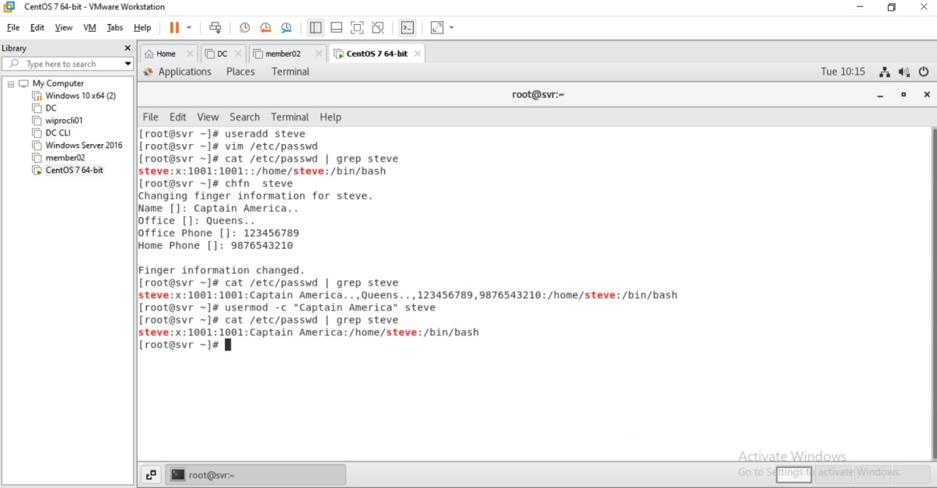

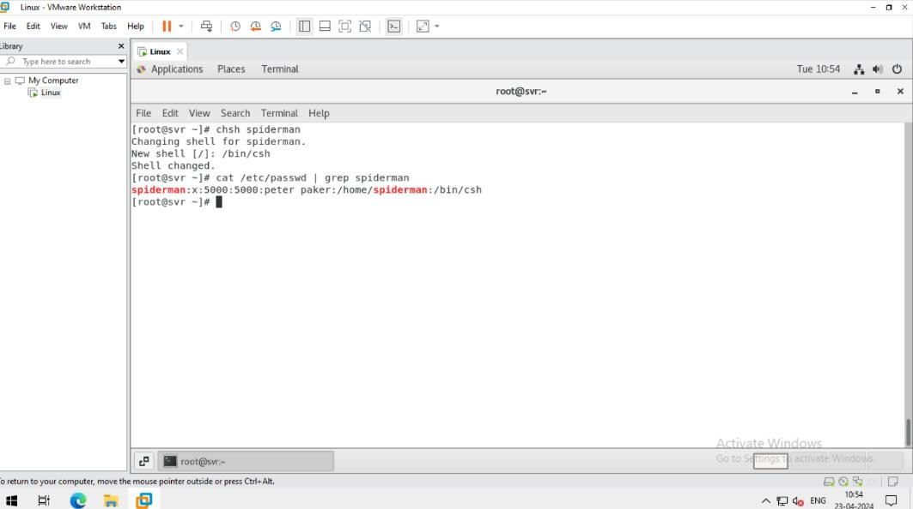
LINUX(day-3)
1. Use “useradd” command
create a user with the following detailsusername: spidermancomment: "Peter Parker"UID: 5000default shell:/bin/kshNote: use only useradd command to do this.
3. Modify user

Slide 2
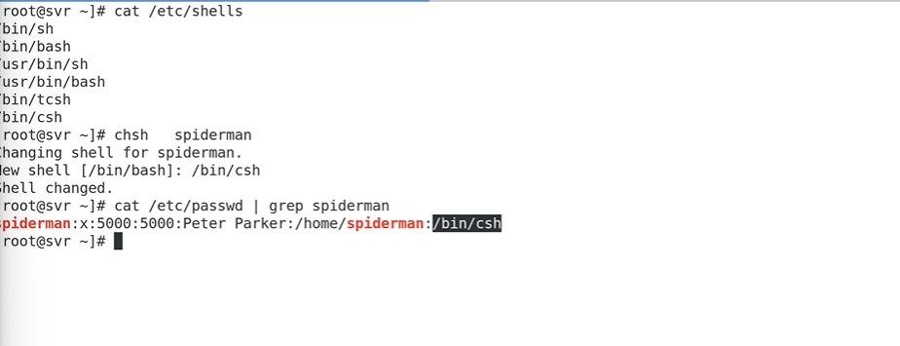
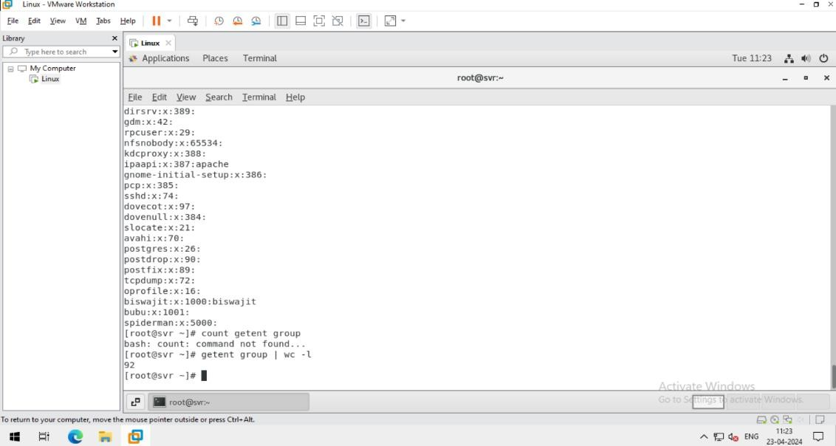
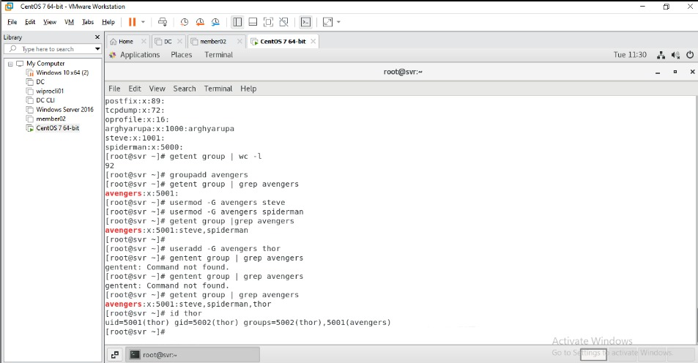
4. Delate user
5. Count the number of group present in system
6. Add user in group

Slide 3
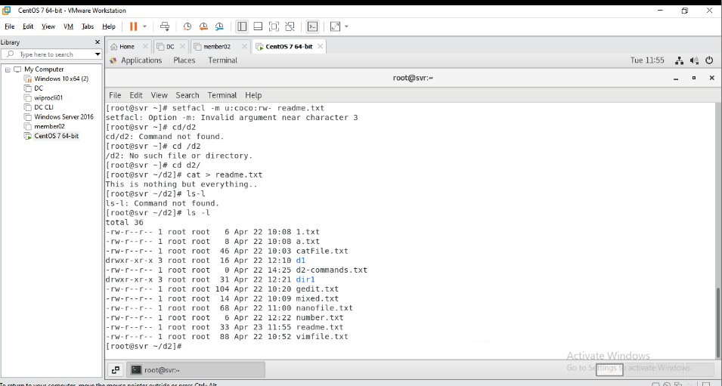
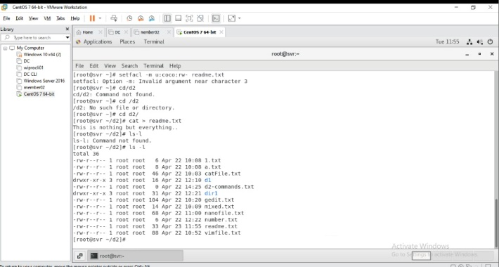
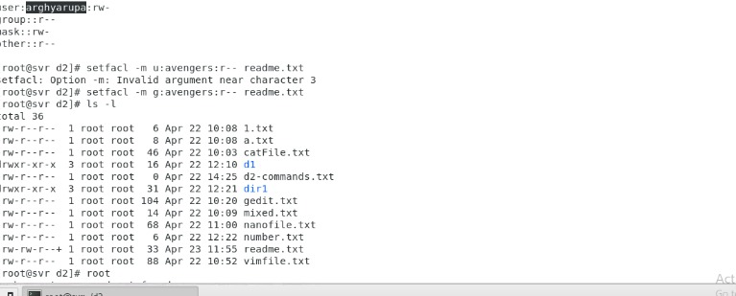
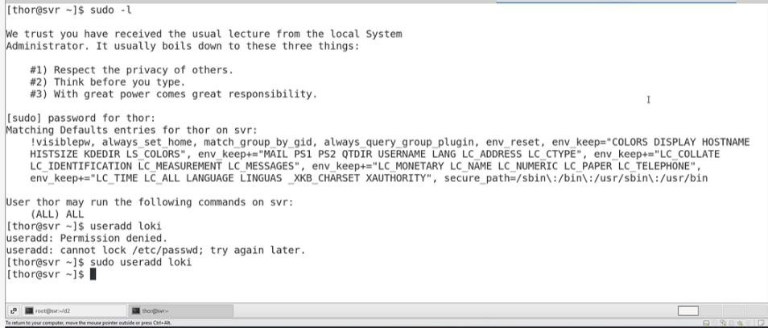
7. ACL (Access Control List)
8. ACL task
9. Sudo user

Slide 4
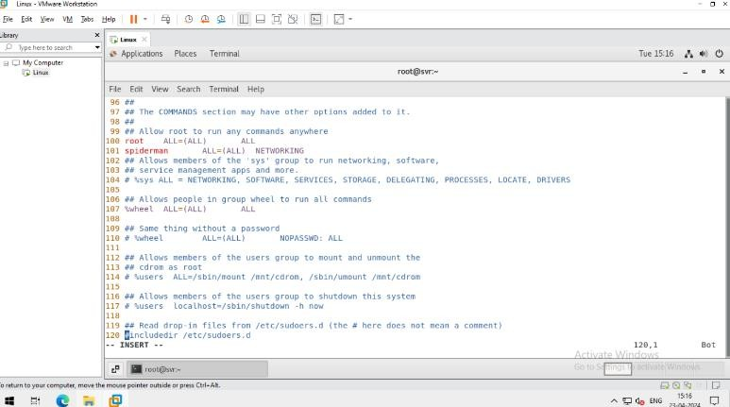
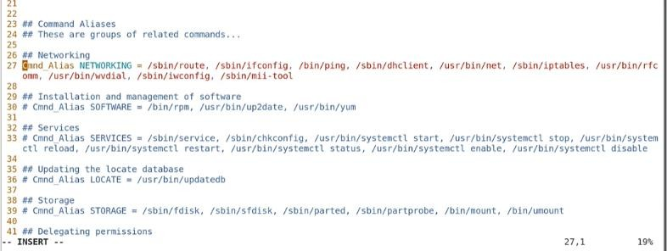
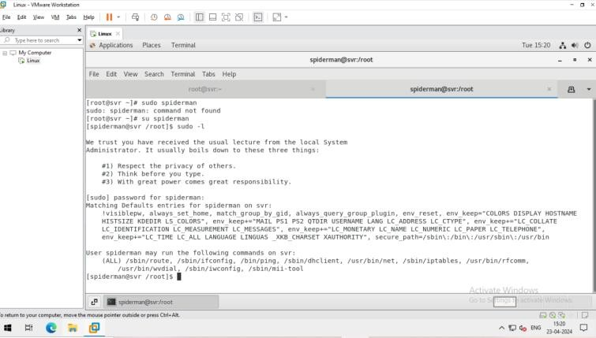
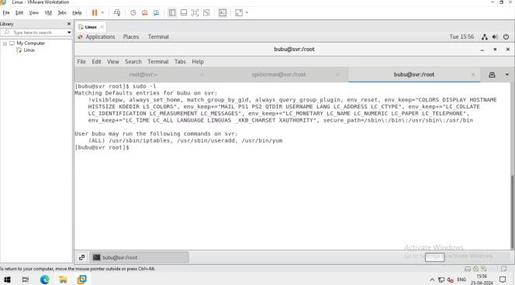
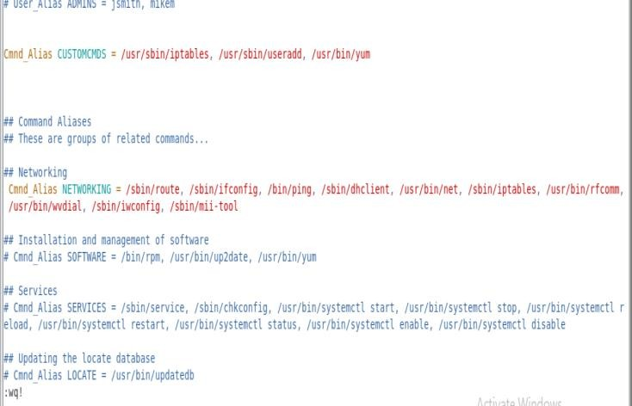
10. Add existing user in SUDO
11. Adding user with custom permissions

Slide 5
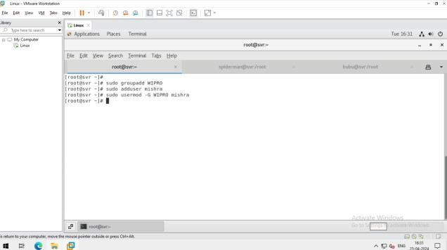
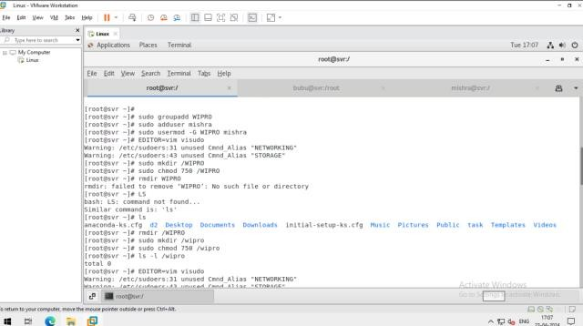
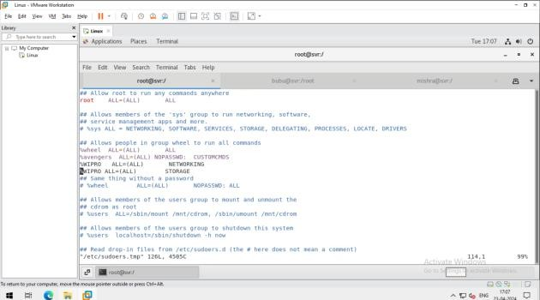
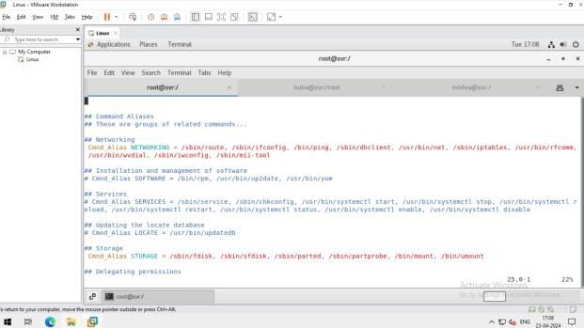
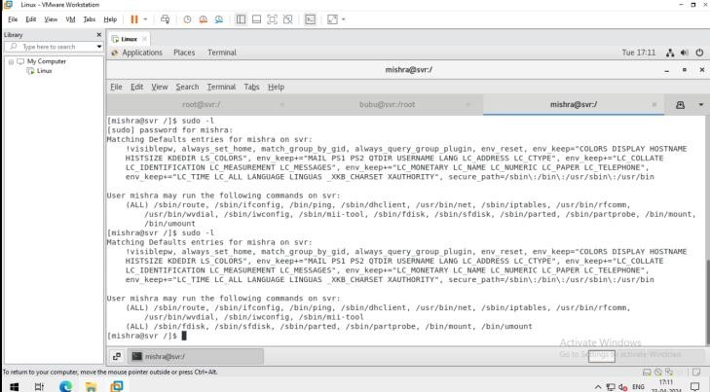
12. Task :- Create a group "WIPRO". Create a user with your last name and add this user to WIPRO group. Give WIPRO group networking and storage permissions and verify. Also, create a new folder "/wipro" & allow the access of read & execution on this group and verify.
has context menu

